Slide 1
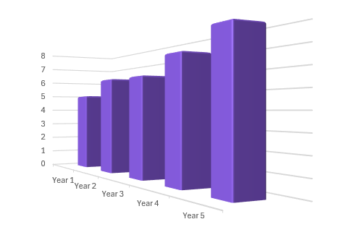
Misleading data
Task A: Misleading graphs
1) Why might the graph in this advert be misleading?
“Studies show our toothpaste is much more effective at promoting healthy teeth and gums than regular toothpaste.”
You may have said:
- No scale on the y axis so the difference in height could be anything.
- The premium toothpaste bar is wider which makes it look like it represents a bigger number.
- No label on the y axis so we do not know what is being measured.
- Use of colour highlights the Premium toothpaste.
Premium toothpaste
Regular toothpaste
2) This chart shows the profit of a company (in thousands) over a 5 year period.
a) What elements of this chart might make it misleading?
Profit (1000s)
A 3D bar chart can make bars in the foreground look like they are bigger.
It is hard to read the exact numbers off the axis.
b) Why do you think the company chose to draw it this way?
To make the yearly profit increase look more impressive.

Slide 2

Misleading data
3) Jacob records the average temperature in one of his classrooms each month and draws this graph.
a) What conclusion might he be trying to convey with this graph?
26
✖
It is significantly hotter in the classroom in July.
Classroom temperature (°C)
25
✖
b) Why is his graph misleading?
✖
✖
✖
It has a broken scale so cannot use proportions.
24
✖
Month
March
April
May
June
July
Sept
The scale is stretched, the actual difference in temperatures is only 2.25°C
He misses out August which makes the peak in July look more significant.
4) Sofia collects this data on how long she spends on different activities on a Saturday.
Activity | Time
Sleeping | 9 hrs
Exercising | 3 hrs
Seeing friends | 4 hrs
Screen time | 5 hrs
Family time | 3 hrs
a) What type of chart could Sofia draw to display this data?
E.g. Bar chart, Pie chart, Pictogram…
b) Sofia wants to make it look like she spends lots of time exercising, how could she manipulate her chart to imply this?
This will depend on the type of graph but some ideas:
Use a 3D pie chart with exercise at the front and the pie chart at an angle.
On a bar chart leave the numbers off the axis.
Draw a 3D bar chart with exercise in the foreground.

Slide 3
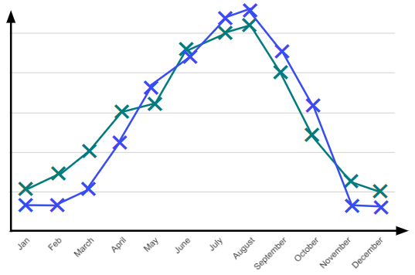


Misleading data
Task B: Misinterpreting graphs
1) Alex drew this chart from data he collected about how pupils travel to school.
60
✖
a) The school newspaper reports, ‘Only 50 pupils walked to school in the 2022/23 academic year’. Is this supported by Alex’s chart?
50
✖
40
✖
Percentage of pupils who walk to school
✖
30
20
No. The y axis is percentage of pupils who walk to school. 50% of pupils walk to school but we do not know how many pupils this is.
10
20/21
21/22
22/23
23/24
year
b) The headline of the article states, ‘Fewer young people choose to walk to school now than in the past’. Is this supported by Alex’s chart?
The chart does seem to show a decrease in the percentage of pupils walking to school, however this chart only goes back as far as 2020 so it is inaccurate to claim that fewer people walk now than ‘in the past’.
✖
2) This time series graph shows the number of shark attacks and the number of heat stroke sufferers throughout the year.
Shark attacks
✖
Cases of heat stroke
The more shark attacks there are the less likely people are to go in the sea so they are more likely to get heat stroke. Shark attacks cause heat stroke!
a) Does the graph support the claim that shark attacks cause heat stroke?
These variables follow a similar pattern but this does not mean that one causes the other. This could be a coincidence or both could be influenced by a third factor.
Jacob
b) Suggest a possible reason why there is a similar pattern between these variables.
Weather and holidays are likely to influence both variables in a similar way. The warmer it is the higher the likelihood of heat stroke and more people will be swimming in the sea so higher chance of shark attacks.

Slide 4


Misleading data
3) Here is a sketch of a scatter graph showing the number of times people visit restaurants and the value of their car.
So all I need to do is eat out more then I will be able to get a fancy car!
Sofia
✖
✖
✖
✖
Value of car
✖
✖
a) Does this graph show correlation between the number of times people visit restaurants and the value of their car? How do you know?
✖
✖
✖
✖
✖
✖
Number of times at a restaurant
Yes, from the limited data there seems to be a positive correlation. The points lie reasonably close to a linear relationship.
b) Explain why Sofia’s statement is incorrect.
Just because there is correlation does not mean one variable causes the other. In this case, people with more money are likely to be able to eat out more and buy more expensive cars.
4) This chart shows the number of people who live in rural areas compared to urban areas.
This shows twice as many people live in urban areas than rural.
Alex
Sofia
I think it shows that 4 times as many people live in urban areas than rural areas.
Rural
Urban
a) Give a reason why Alex may be correct.
The height of the picture for urban areas is twice that of the picture for rural areas.
b) Give a reason why Sofia may be correct.
The area of the picture for urban areas is four times that of the picture for rural areas.
c) Give a reason why both may be incorrect.
There is no scale on the y axis, if the scale does not start at zero then comparing proportions is incorrect.
It is impossible to interpret what this graph is showing.
Mathematics in Education and Industry
v2.4

